Slide 1
Event Detection in Twitter
Joan Capdevila ^{(1,2)}
Advisors: Jesús Cerquides ⁽³⁾, Jordi Torres ^{(1,2)}
(1) Department d’Arquitectura de Computadors, Universitat Politècnica de Catalunya (AC-UPC)
(2) Barcelona Supercomputing Center (BSC-CNS)
(3) Institut d’Investigació en Intel·ligència Artificial (IIIA-CSIC)

Slide 2

Outline
Introduction
Motivation
Event detection in Twitter
Crawling Twitter
Social Network API
Twitter APIs [.iypnb]
“La Mercè” dataset
Tweet-SCAN
Background
DBSCAN [.ipynb]
Topic models [.ipynb]
Specification
Justify the textual component
Lessons learned
Open issues
Warble
Background
Mixture Models [.ipynb]
Specification
Comparative evaluation
Lessons learned
Open issues

Slide 3
Motivation example
https://www.youtube.com/watch?v=0UFsJhYBxzY

Slide 4
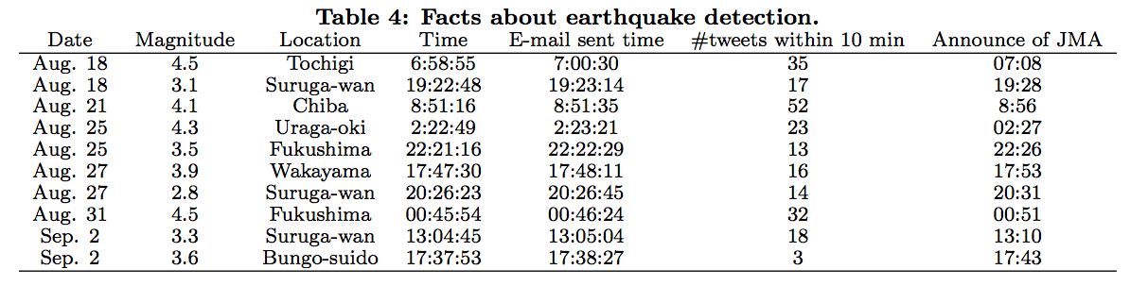
Motivation example
5 min
Sakaki, Takeshi, Makoto Okazaki, and Yutaka Matsuo. "Earthquake shakes Twitter users: real-time event detection by social sensors." Proceedings of the 19th international conference on World wide web. ACM, 2010.

Slide 5
Motivation
Social networks have shown to detect certain events much faster than:
traditional media (e.g. Rambla’s shooting or Osama Bin Laden raid).
sensor networks (e.g. Japan Meteorological Agency).
Moreover, social networks can detect various type of events:
Breaking news (Sankaranarayanan et al. 2009)
Natural phenomena (Sakaki et al. 2010)
Entertainment events (Benson et al. 2011)
Traffic incidents (Cheng and Wicks 2014)
Disease outbreaks (Cheng and Neil 2014)
Finally, social networks enable to give answer to:
What? Where? When? Who? (Yuan, Quan, et al. 2015)
Automated event summarization (Chakrabarti et al. 2011)

Slide 6
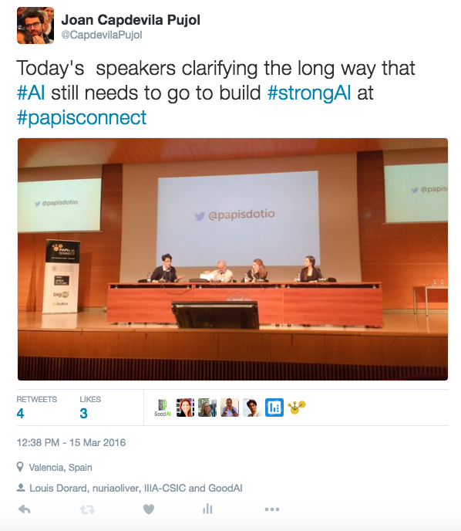
What’s in a tweet?
User (“Who?”)
Informal short text (“What?”)
Image (“What?”)
Timestamp (“When?”)
Location (“Where?”)
(“Who?”)

Slide 7
Event definition in Social Networks
McMin et al. 2013 “an event is something significant that happens at specific time and place”.
Panagiotou et al. 2016 “an event is something that cause (a large number of) actions in the social network”.
Based on event detection in sensor networks (Wong and Neil 2009), we consider an “event as something that cause an abnormal number of actions in the social network”.
Wong, Weng-Keen, and Daniel B. Neill. "Tutorial on Event Detection KDD 2009." Age 9 (2009): 30.

Slide 8
Event types in Social Networks
Event type | Restrictions in When? | Restrictions in Where? | Restrictions in Who/What? | Example
Breaking News | High | Low | Medium | Michael Jackson death
Global | Low | Low | Medium | Global warming
Local | Low | High | Low | Shooting in Ramblas
Entity-related | High | Low | High | Release of new iphone
Event type | Restrictions in When? | Restrictions in Where? | Restrictions in Who/What? | Example
Breaking News | High | Low | Medium | Michael Jackson death
Global | Low | Low | Medium | Global warming
Local | Low | High | Low | GoT actor in Cul de la lleona
Entity-related | High | Low | High | Release of new iphone
Panagiotou, Nikolaos, Ioannis Katakis, and Dimitrios Gunopulos. "Detecting Events in Online Social Networks: Definitions, Trends and Challenges.” in Solving Large Scale Learning Tasks: Challenges and Algorithms, S. Michaelis, N. Piatkowski, and M. Stolpe, Eds., Springer International Publishing, 2016.

Slide 9
Event detection
Goals of event detection:
Event identification
Accuracy – detect as accurately as possible
Quickness – detect as quickly as possible
Event summarization
Pinpoint the affected subgroups of data
Severity/magnitude of the event
Types:
Retrospective or batch: detect events from historical data.
Prospective or online: detect current events.

Slide 10
Event detection
Goals of event detection:
Event identification
Accuracy – detect as accurately as possible
Quickness – detect as quickly as possible
Event summarization
Pinpoint the affected subgroups of data
Severity/magnitude of the event
Types:
Retrospective or batch: detect events from historical data.
Prospective or online: detect current events.

Slide 11
CRAWLING TWITTER

Slide 12





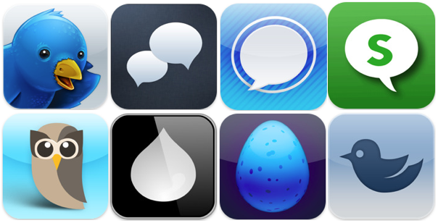
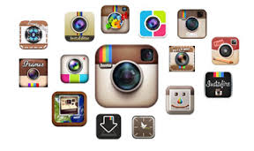
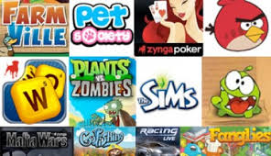
Social Network APIs
APIs
APPs

Slide 13
Twitter APIs
Create Twitter account and link it with a cellphone number.
Register the app at https://apps.twitter.com/
Get the Oauth credentials: CONSUMER_KEY, CONSUMER_SECRET, ACCESS_TOKEN, ACCESS_SECRET
Request Twitter data through authenticated HTTP Requests (GET; POST) to:
REST API
Streaming API
Keep track of the number of petitions to not exceed the limits.

Slide 14
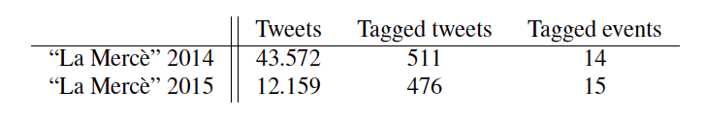
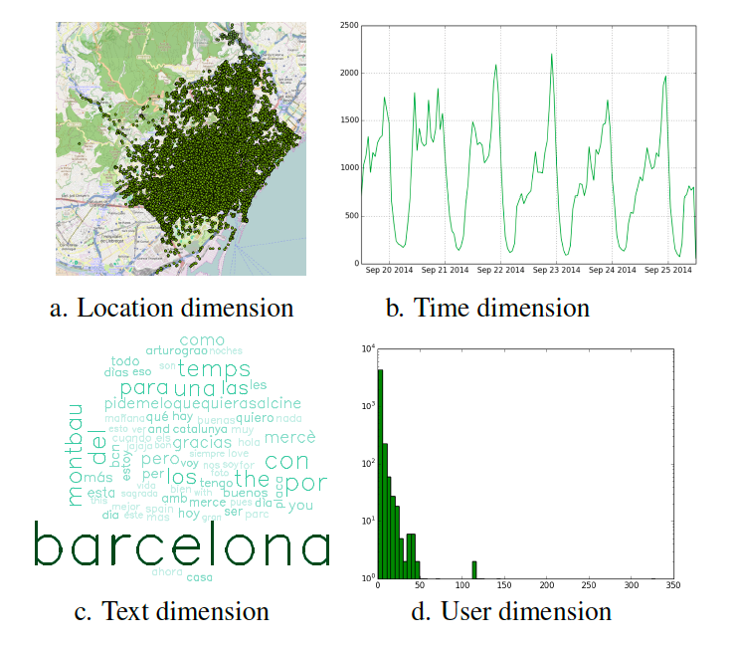
A dataset for local event detection: “La Mercè”

Slide 15
Tweet-SCAN
Joan Capdevila, Jesús Cerquides, Jordi Nin, Jordi Torres,
Tweet-SCAN: An event discovery technique for geo-located tweets,
Pattern Recognition Letters, Available online 25 August 2016

Slide 16
Introduction
Based on Density-based Spatial Clustering of Applications with Noise (DBSCAN).
Uses probabilistic topic models for the textual component.
Considers the spatial, temporal, textual and user features of a tweet.
Aims to discover density-connected sets of tweets that might be related to a local event.

Slide 17
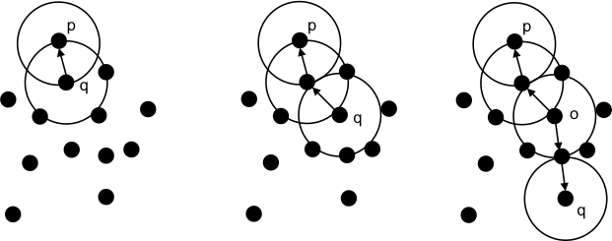
DBSCAN
Defines two predicates:
Neighborhood:
Cardinality:
Directly
density-reachable
Density-reachable
Density-connected
A DBSCAN cluster is a set of density-connected points that contain all possible density-reachable points.

Slide 18
DBSCAN
DBSCAN clustering results for a given ε and MinPts.
Noise point
Border point
Core point

Slide 19
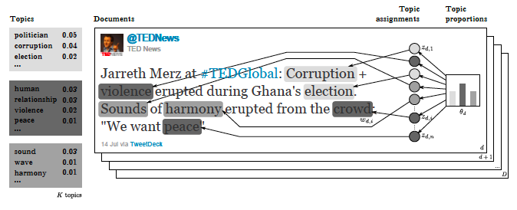
Probabilistic topic models
Latent Dirichlet Allocation (LDA) (Blei et al. 2013)
Fig. - Xuriguera et al. 2013

Slide 20
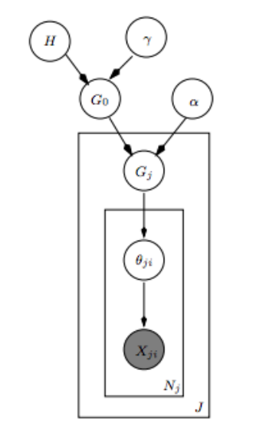
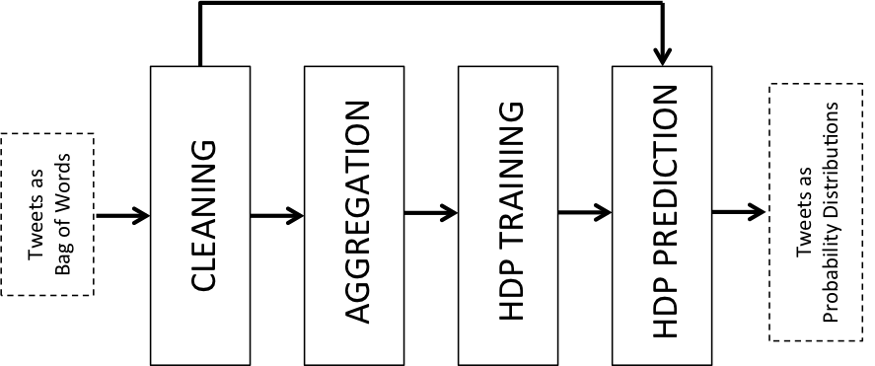
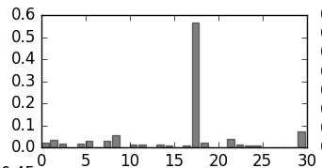
Tweet-SCAN text model
Hierarhical Dirichlet Process (HDP)
(Teh et al. 2006)

Slide 21
Tweet-SCAN
extends DBSCAN to consider tweet features
Neighborhood:
Cardinality:
Euclidean distance for the spatio-temporal features
Jensen-shannon distance for the textual features
Udiv(.) is the ratio of unique users within the ε-neighborhood

Slide 22
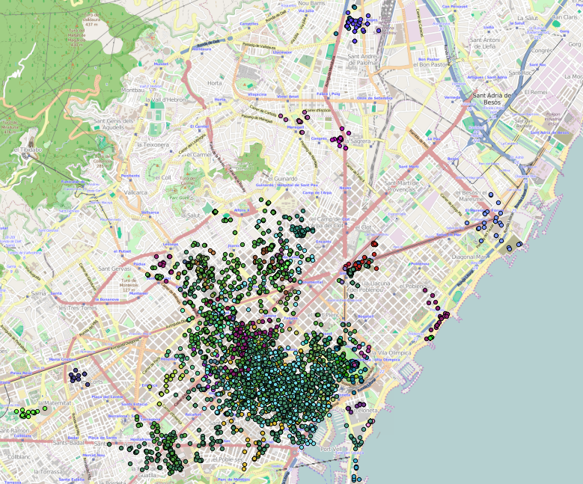
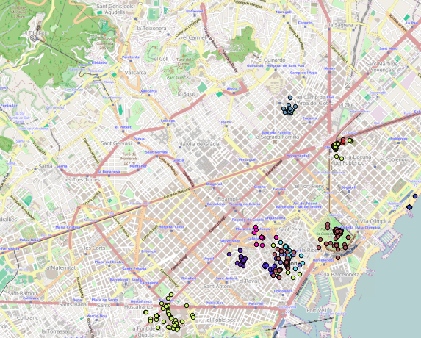
Why text matters? (Visually)
Tweet-SCAN ε₃ = 1
Tweet-SCAN ε₃ = 0.7

Slide 23
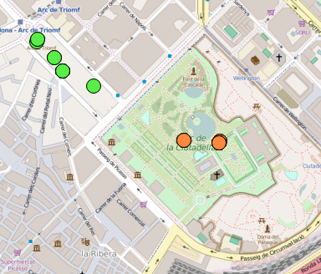
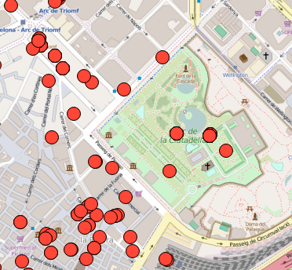
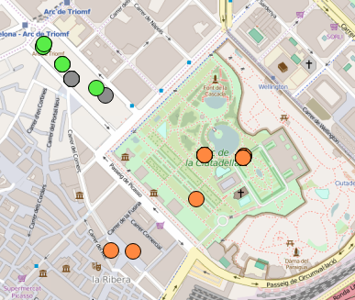
Why text matters? (Visually)
Labeled events
Tweet-SCAN ε₃ = 1
Tweet-SCAN ε₃ = 0.8
Wine tasting fair
Food Market

Slide 24
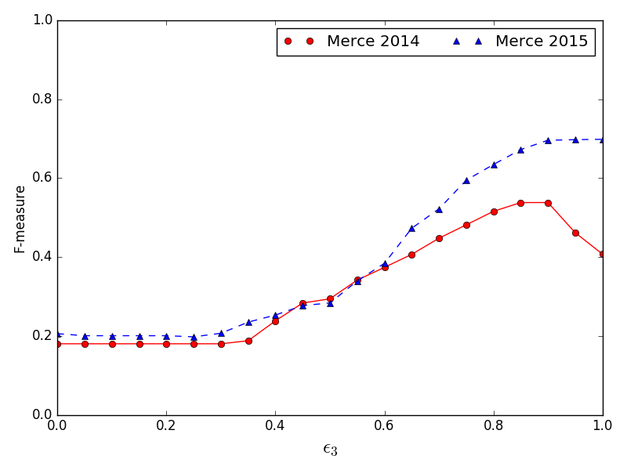
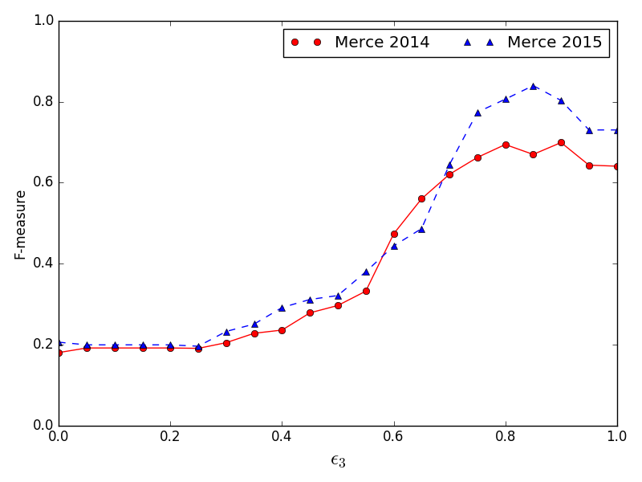
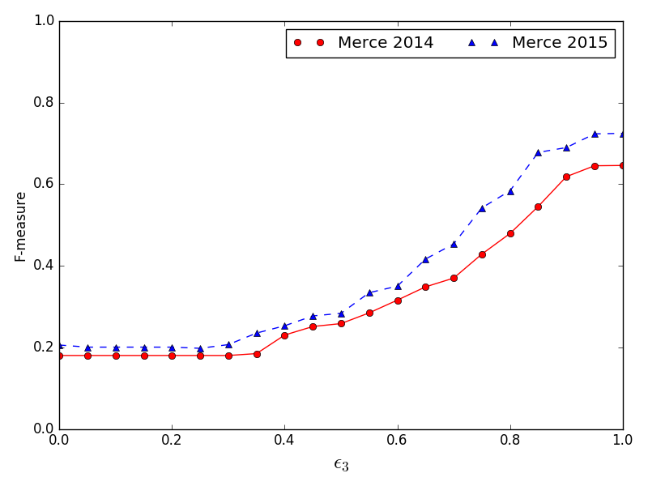
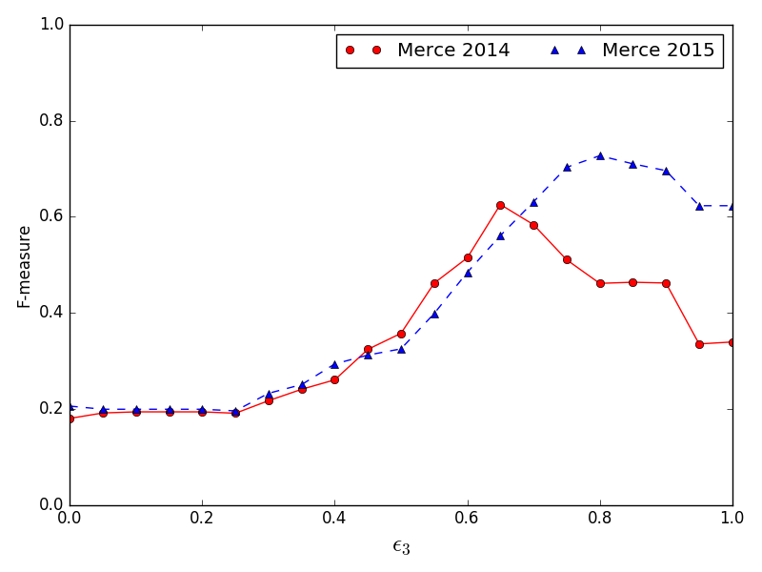
Why text matters? (F-measure)
ε₁= 250m ε₂= 1800s
ε₁= 250m ε₂= 3600s
ε₁= 500m ε₂= 1800s
ε₁= 500m ε₂= 3600s

Slide 25
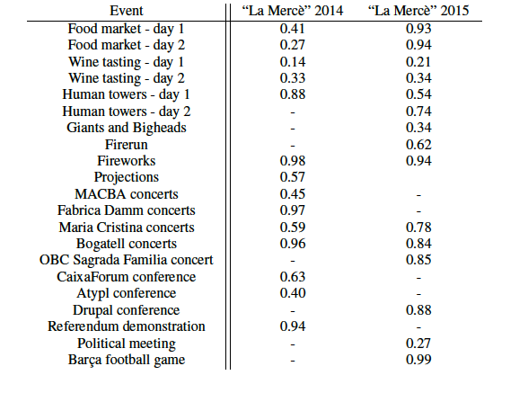
F-measure per event

Slide 26
Lessons learned
Considering text features helps in:
Associating Tweet-SCAN clusters with real-world events
Distinguishing between events
Although it is not here,
We showed that more fine-grained text models improve the overall detection performance.
User diversity parameters helps to filter Twitter bots out.

Slide 27
What’s next?
Can we take into account varying tweet distributions?
Can we develop a probabilistic model that integrates topic modeling with event detection?

Slide 28
WARBLE
Joan Capdevila, Jesús Cerquides and Jordi Torres.
"Recognizing warblers: a probabilistic model for event detection in Twitter”
ICML Anomaly Detection Workshop (2016)
An extended version submitted to a journal

Slide 29
Introduction
Based on Heterogeneous Mixture Models.
Captures non-event tweets in the background component.
Takes into account the space-time variability of non-event tweets.
It jointly learns topics and events through the same learning scheme.

Slide 30
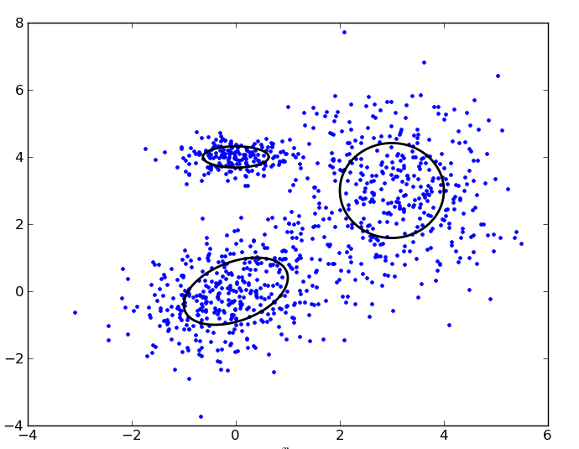
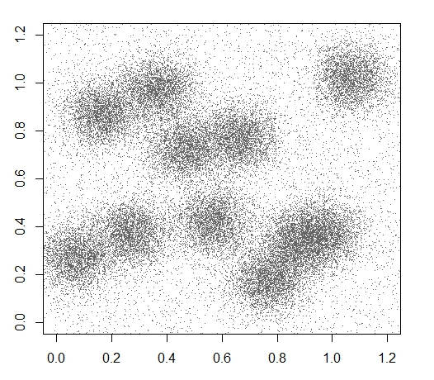
Heterogeneous Mixture Models
Homogenous Gaussian MM
3 Gaussians
Heterogeneous MM (Banfield et al. ’93)
10 Gaussians + 1 Uniform

Slide 31
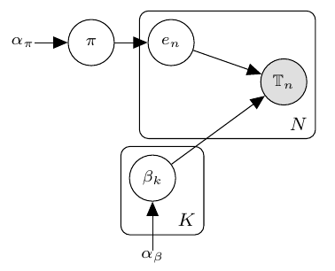
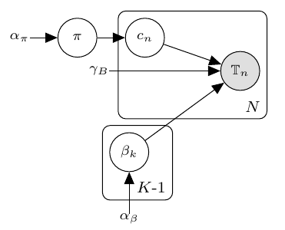
A background component for non-event tweets
Homogeneous mixture model
for event detection
(McInerney and Blei 2014)
Warble: Heterogeneous mixture model
for event detection

Slide 32
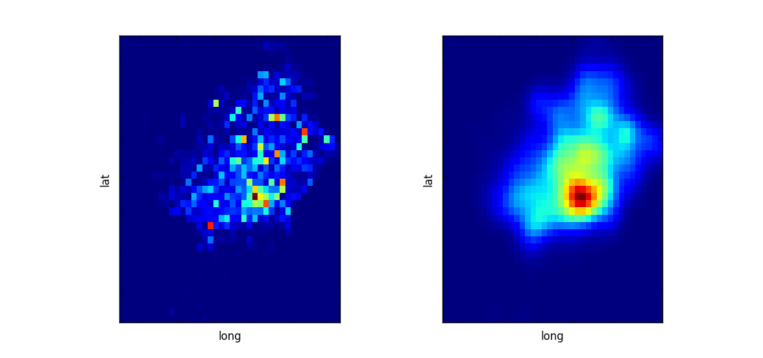
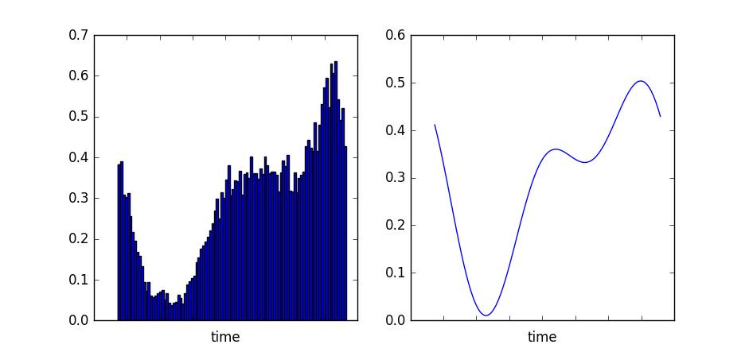
Space-time backgrounds

Slide 33
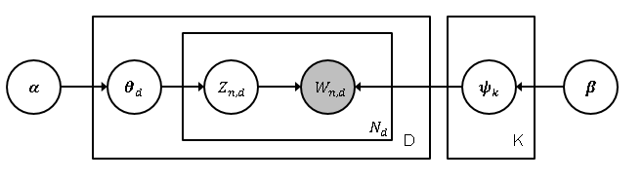
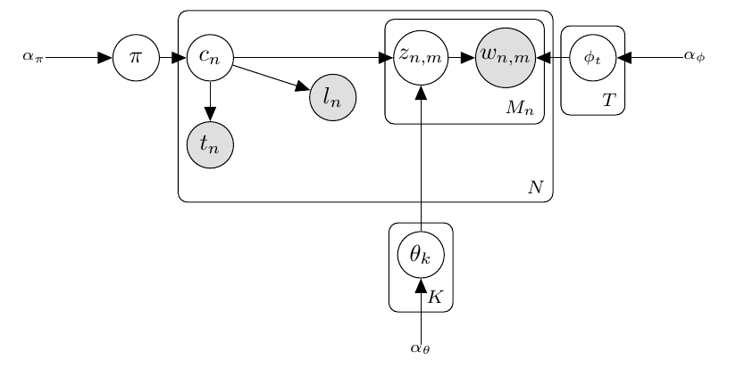
Joint topic-event learning
Latent Dirichlet Allocation (LDA)
(Blei et al. 2003)
T
Warble topic model

Slide 34
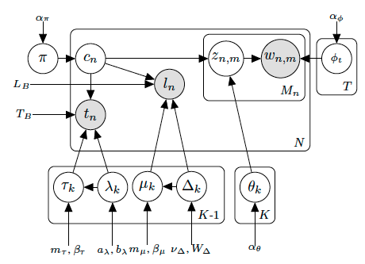
The complete WARBLE model

Slide 35
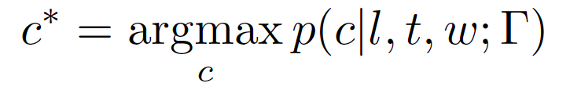
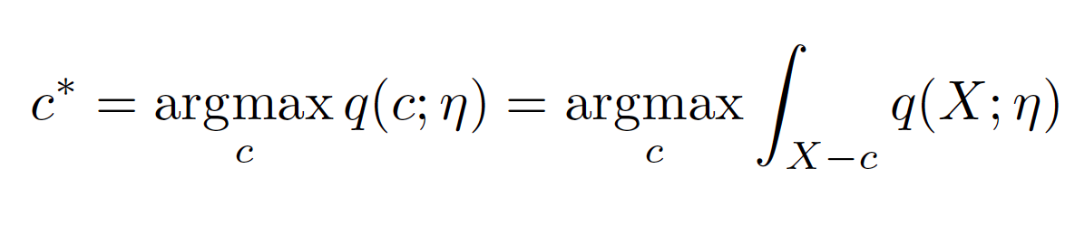
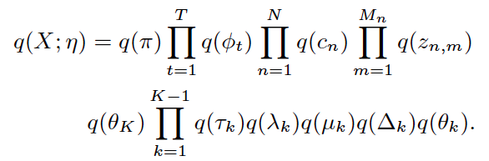
How to learn the Warble model from tweets?
Historical background
From tweets previous to the period of interest
Approximate inference
Goal:
Variational inference:
Mean-field approximation:

Slide 36
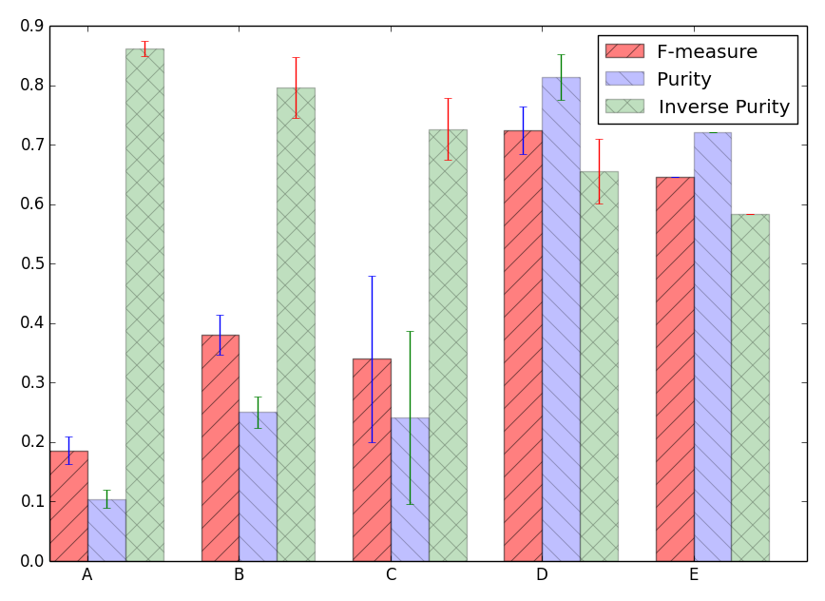
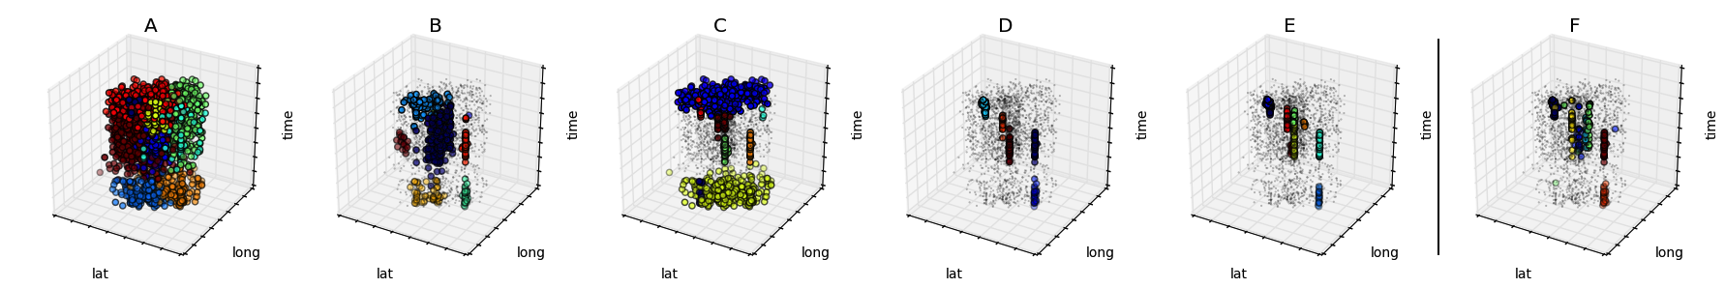
Evaluation
A – McInerney & Blei model
B – Warble without joint topic event learning
C – Warble without background
D – The complete Warble
E – Tweet-SCAN

Slide 37
Evaluation
A – McInerney & Blei model B – Warble w/o joint topic-event learning C – Warble w/o background
D – The complete Warble E – Tweet-SCAN F – Labeled events

Slide 38
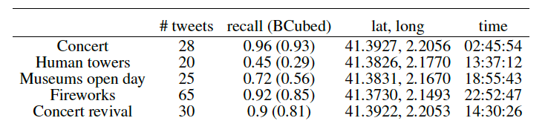
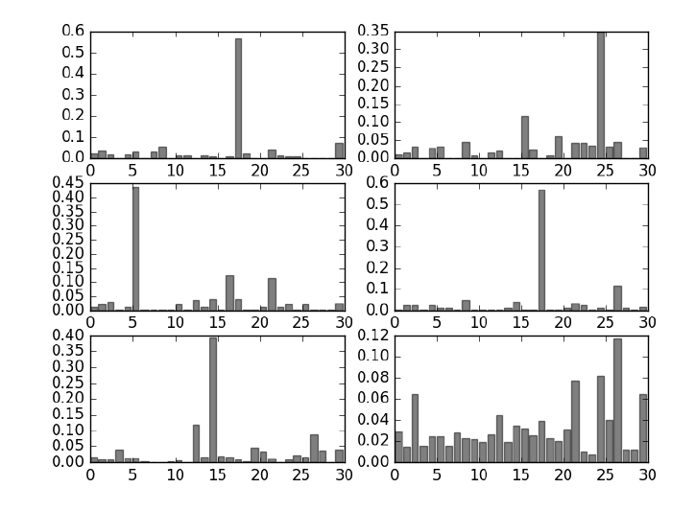
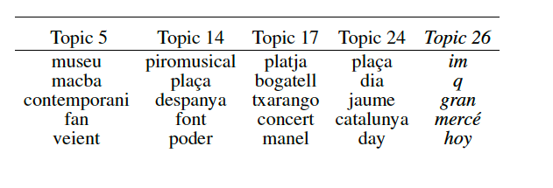
Event summarization

Slide 39
Lessons learned
Heterogeneous mixture models enable to account for the ‘normality’ (non-event tweets) and abnormal patterns (events).
To simultaneously consider the spatio-temporal background and the joint topic-event learning, significantly improves the detection performance.
Warble performance is comparable to that of Tweet-SCAN.
Probabilistic models intrinsically provide event summarization.

Slide 40
What’s next?
Non-parametric extensions that allow data to determine the model complexity (# of topics (T) and # of events (K))
Account for partially-observed data in a principled probabilistic way (i.e. tweets without precise geo-location)
Validate our preliminary results in other data sets.
Compare against other state-of-the-art event detection techniques.

Slide 41
Questions?
Thanks for your attention!

